Slide 1
Recurrent neural network
Hung-Hsuan Chen
Most slides are taken from Fei-Fei Li @Stanford

Slide 2
Sequential pattern mining
The current output depends on the neighboring (e.g., previous or next) outputs
Stock market: today’s price is dependent on yesterday’s price
Grammar parser: the POS (Part-of-Speech) of a word depends on the POS of its neighboring words

Slide 3
Sequential pattern mining by SVM/logistic regression/decision trees/NN/…
The “sequential” info has to be encoded into the feature manually
E.g.,
Stock market: use the price of yesterday, last 3 days, last week, etc. as the features to predict today’s price
Grammar parser: use the predicted POS of the next word and the predicted POS of the previous word as the features to predict the POS of the current word

Slide 4
“Vanilla” neural network (based on the definition in “The Elements of Statistical Learning”)
A single hidden layer back-propagation network
a.k.a., single layer perceptron

Slide 10
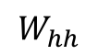
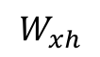
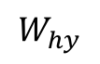
$$W_{hy}$$
$$W_{hh}$$
$$W_{xh}$$

Slide 11
Summing up the loss as the total loss
One W is used at all time steps
Summing up the gradients to update W

Slide 17
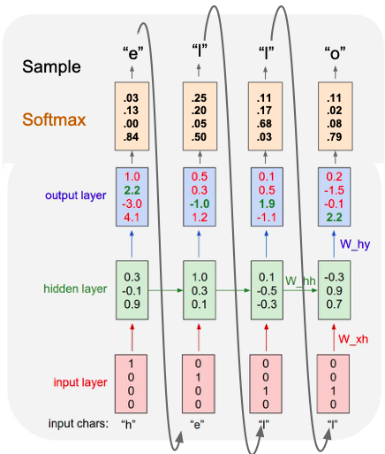
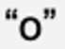
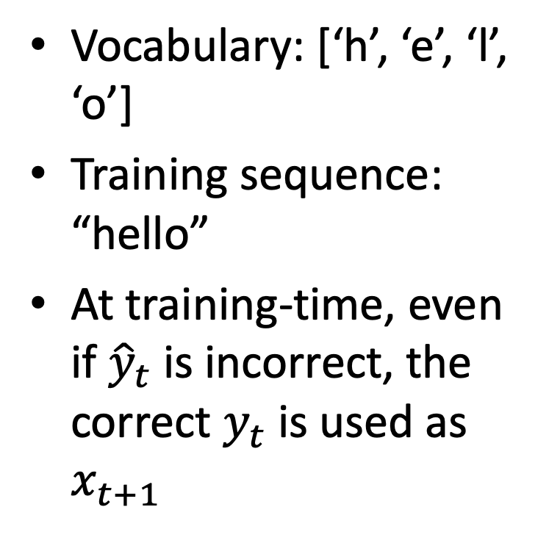
Example: character-level Language Model – training
Vocabulary: [‘h’, ‘e’, ‘l’, ‘o’]
Training sequence: “hello”
At training-time, even if ${\hat{y}}_{t}$ is incorrect, the correct $y_{t}$ is used as $x_{t+1}$
wrong
wrong
right
right

Slide 18
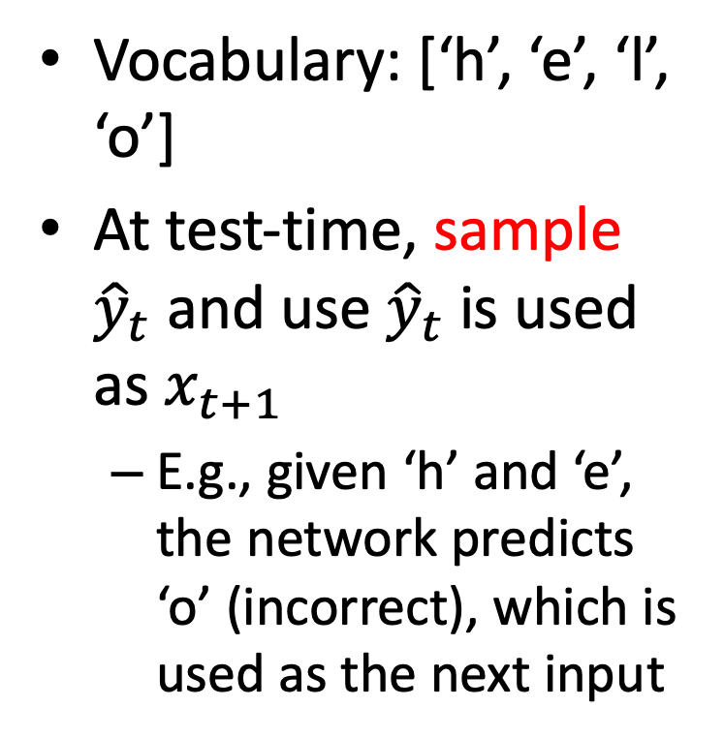
Example: character-level Language Model – test
Vocabulary: [‘h’, ‘e’, ‘l’, ‘o’]
At test-time, sample ${\hat{y}}_{t}$ and use ${\hat{y}}_{t}$ is used as $x_{t+1}$
E.g., given ‘h’ and ‘e’, the network predicts ‘o’ (incorrect), which is used as the next input
right
wrong
right
right

Slide 20
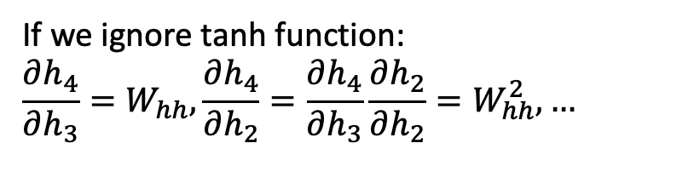
If we ignore tanh function:
$$\frac{∂h_{4}}{∂h_{3}}=W_{hh}, \frac{∂h_{4}}{∂h_{2}}=\frac{∂h_{4}}{∂h_{3}}\frac{∂h_{2}}{∂h_{2}}=W_{hh}^{2}, …$$

Slide 24
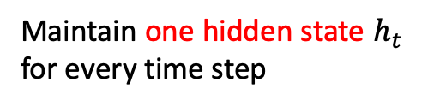
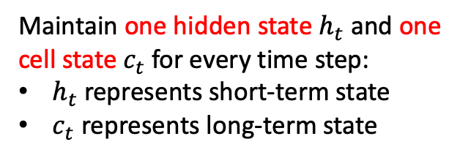
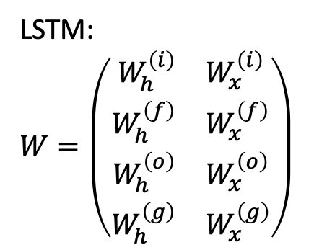
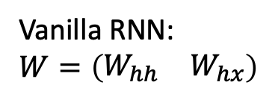
LSTM:
$$W=\left(\begin{aligned}\begin{matrix}W_{h}^{\left(i\right)} & W_{x}^{\left(i\right)}\end{matrix} \\ \begin{matrix}W_{h}^{\left(f\right)} & W_{x}^{\left(f\right)}\end{matrix} \\ \begin{matrix}W_{h}^{\left(o\right)} & W_{x}^{\left(o\right)}\end{matrix} \\ \begin{matrix}W_{h}^{\left(g\right)} & W_{x}^{\left(g\right)}\end{matrix}\end{aligned}\right)$$
Vanilla RNN: $$W=\left(\begin{matrix}W_{hh} & W_{hx}\end{matrix}\right)$$
Maintain one hidden state $h_{t}$ for every time step
Maintain one hidden state $h_{t}$ and one cell state $c_{t}$ for every time step:
$h_{t}$ represents short-term state
$c_{t}$ represents long-term state

Slide 25
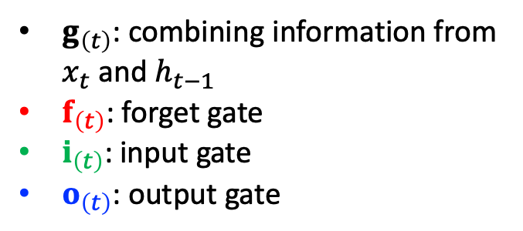
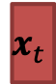
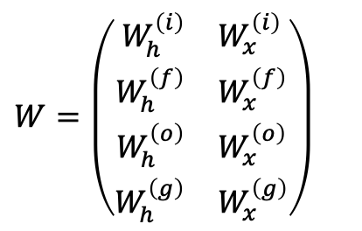
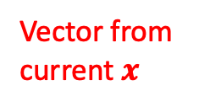
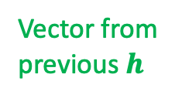
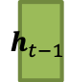
$$W=\left(\begin{aligned}\begin{matrix}W_{h}^{\left(i\right)} & W_{x}^{\left(i\right)}\end{matrix} \\ \begin{matrix}W_{h}^{\left(f\right)} & W_{x}^{\left(f\right)}\end{matrix} \\ \begin{matrix}W_{h}^{\left(o\right)} & W_{x}^{\left(o\right)}\end{matrix} \\ \begin{matrix}W_{h}^{\left(g\right)} & W_{x}^{\left(g\right)}\end{matrix}\end{aligned}\right)$$
$g_{\left(t\right)}$: combining information from $x_{t}$ and $h_{t−1}$
$f_{\left(t\right)}$: forget gate
$i_{\left(t\right)}$: input gate
$o_{\left(t\right)}$: output gate
Vector from previous $h$
$$h_{t−1}$$
$$x_{t}$$
Vector from current $x$

Slide 26
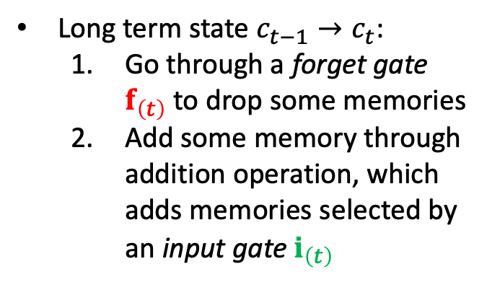
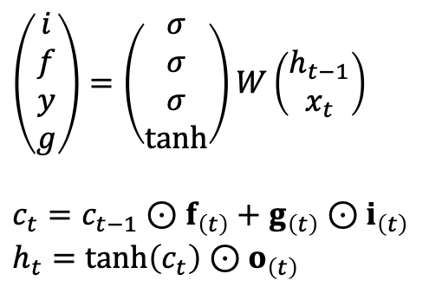
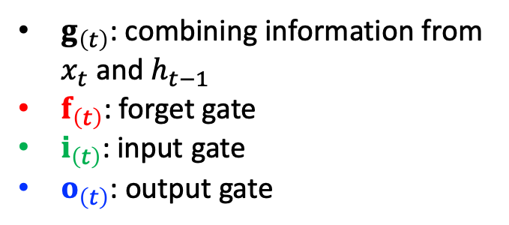
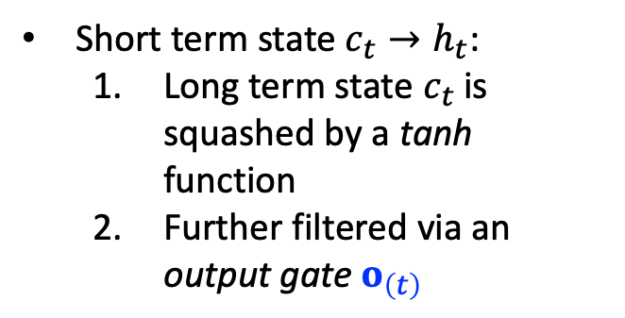
$g_{\left(t\right)}$: combining information from $x_{t}$ and $h_{t−1}$
$f_{\left(t\right)}$: forget gate
$i_{\left(t\right)}$: input gate
$o_{\left(t\right)}$: output gate
Long term state $c_{t−1}→c_{t}$:
Go through a forget gate $f_{\left(t\right)}$ to drop some memories
Add some memory through addition operation, which adds memories selected by an input gate $i_{\left(t\right)}$
Short term state $c_{t}→h_{t}$:
Long term state $c_{t}$is squashed by a tanh function
Further filtered via an output gate $o_{\left(t\right)}$
$$\left(\begin{aligned}i \\ f \\ y \\ g\end{aligned}\right)=\left(\begin{aligned}σ \\ σ \\ σ \\ tanh\end{aligned}\right)W\left(\begin{aligned}h_{t−1} \\ x_{t}\end{aligned}\right)$$
$$c_{t}=c_{t−1}⊙f_{\left(t\right)}+g_{\left(t\right)}⊙i_{\left(t\right)}$$
$$h_{t}=\tanh\left(c_{t}\right)⊙o_{\left(t\right)}$$

Slide 27
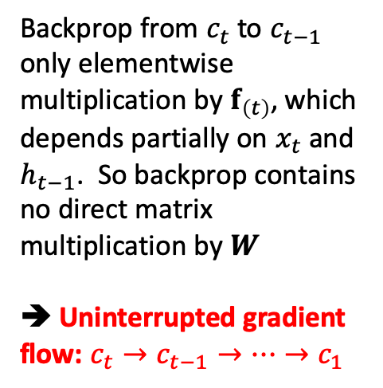
Backprop from $c_{t}$ to $c_{t−1}$ only elementwise multiplication by $f_{\left(t\right)}$, which depends partially on $x_{t}$ and $h_{t−1}$. So backprop contains no direct matrix multiplication by $W$
➔ Uninterrupted gradient flow: $c_{t}→c_{t−1}→…→c_{1}$

Slide 28
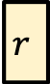

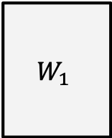


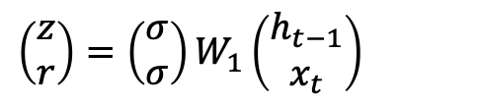
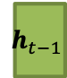
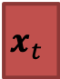
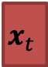
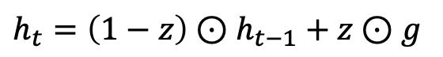
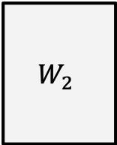
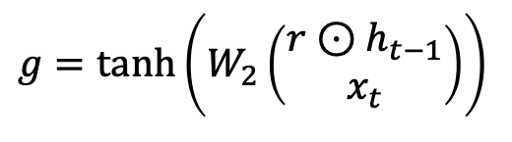
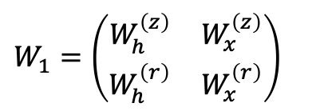
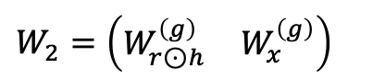
Gated recurrent unit (GRU)
$$W_{1}$$
$$h_{t−1}$$
sigmoid
$$z$$
$$\left(\begin{matrix}z \\ r\end{matrix}\right)=\left(\begin{matrix}σ \\ σ\end{matrix}\right)W_{1}\left(\begin{aligned}h_{t−1} \\ x_{t}\end{aligned}\right)$$
$$x_{t}$$
sigmoid
$$r$$
2h x 2h
2h
$$W_{1}=\left(\begin{aligned}\begin{matrix}W_{h}^{\left(z\right)} & W_{x}^{\left(z\right)}\end{matrix} \\ \begin{matrix}W_{h}^{\left(r\right)} & W_{x}^{\left(r\right)}\end{matrix}\end{aligned}\right)$$
$$W_{2}$$
$$r⊙$$
$$h_{t−1}$$
tanh
$$g$$
$$g=\tanh\left(W_{2}\left(\begin{aligned}r⊙h_{t−1} \\ x_{t}\end{aligned}\right)\right)$$
$$x_{t}$$
2h x 2h
2h
$$W_{2}=\left(\begin{matrix}W_{r⊙h}^{\left(g\right)} & W_{x}^{\left(g\right)}\end{matrix}\right)$$
$$h_{t}=\left(1−z\right)⊙h_{t−1}+z⊙g$$

Slide 29
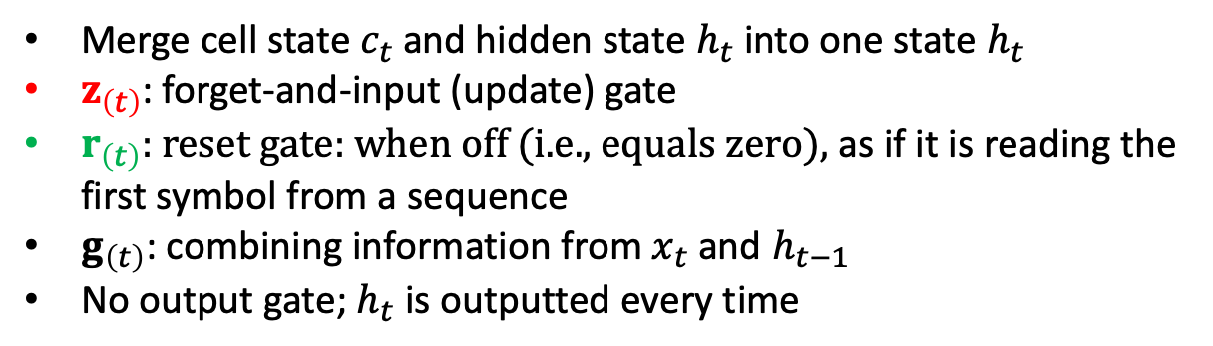
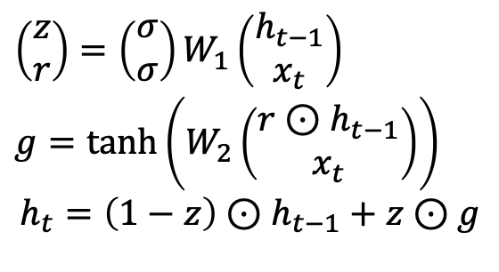
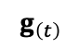
Merge cell state $c_{t}$ and hidden state $h_{t}$ into one state $h_{t}$
$z_{\left(t\right)}$: forget-and-input (update) gate
$r_{\left(t\right)}$: reset gate: when off (i.e., equals zero), as if it is reading the first symbol from a sequence
$g_{\left(t\right)}$: combining information from $x_{t}$ and $h_{t−1}$
No output gate; $h_{t}$ is outputted every time
$$g_{\left(t\right)}$$
$$\left(\begin{matrix}z \\ r\end{matrix}\right)=\left(\begin{matrix}σ \\ σ\end{matrix}\right)W_{1}\left(\begin{aligned}h_{t−1} \\ x_{t}\end{aligned}\right)$$
$$g=\tanh\left(W_{2}\left(\begin{aligned}r⊙h_{t−1} \\ x_{t}\end{aligned}\right)\right)$$
$$h_{t}=\left(1−z\right)⊙h_{t−1}+z⊙g$$

Slide 30
Bidirectional RNN
For certain tasks, seeing “future” inputs is reasonable
E.g., when translating from English to Chinese, we don’t translate word-by-word; we read the entire sentence (or paragraph) and translate
“Previous” words and “future words” together influence the selection of the current word
Bidirectional RNN
Run a RNN from left to right
Run another RNN from right to left
Combine (e.g., concatenate) their outputs at each time step

Slide 31
Bidirectional RNN

Slide 33
WaveNet

Slide 34
WaveNet structure
Stacked 1D convolution layers
Doubling the dilation rate (how spread apart each neuron’s inputs are) at each layer
1st convolutional layer gets 2 time steps
2nd convolutional layer gets 4 time steps
3rd convolutional layer gets 8 time steps
Overall, lower layers learn short-term patterns; higher layers learn long-term patterns
Efficiently process large sequences

Slide 35
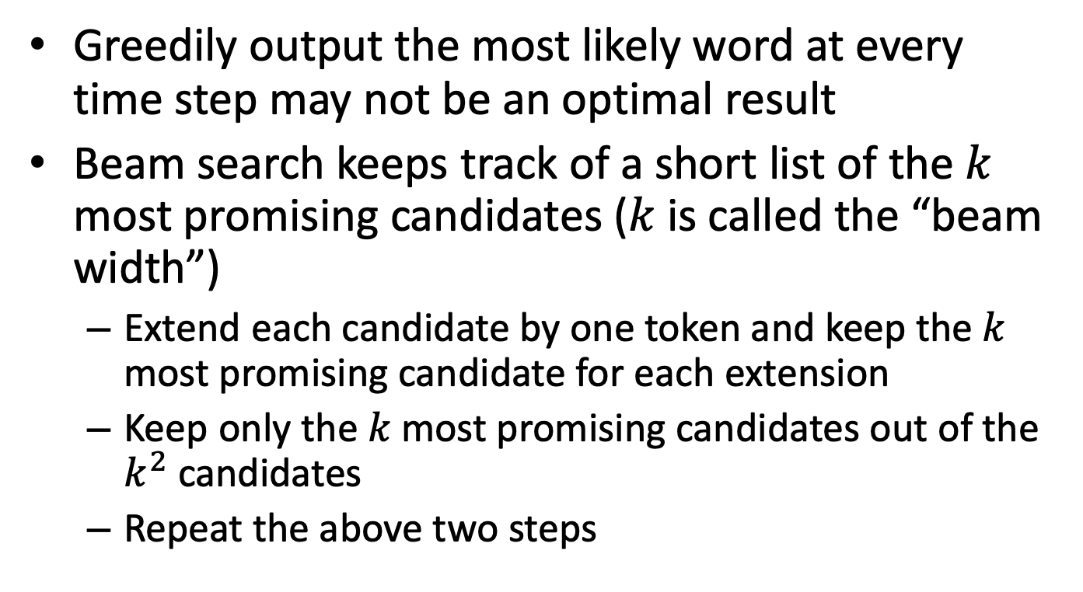
Beam search
Greedily output the most likely word at every time step may not be an optimal result
Beam search keeps track of a short list of the $k$ most promising candidates ($k$ is called the “beam width”)
Extend each candidate by one token and keep the $k$ most promising candidate for each extension
Keep only the $k$ most promising candidates out of the $k^{2}$ candidates
Repeat the above two steps

Slide 36
Example: French to English translation
Jane visite l’Afrique en septembre
Steps
Out of 10,000 possible English words as the beginning, select the top 3
[In, Jane, September]
Extend each candidate’s top 3 candidates
[In [September, the, this]]
[Jane [is, wants, will]]
[September [is, seems, will]]
Select top 3 among them
[In September], [Jane is], [Jane will]
…
The example is taken from https://medium.com/@dhartidhami/beam-search-in-seq2seq-model-7606d55b21a5

